Slide 1



AUTOMATED WATERING SYSTEM AND PET cat FEED dispatcher
CSE 316: PROJECT
JIHAD (2105011), MAHI (2105013) AND saif (2105030)

Slide 2
Project Objectives and Goals
Main Objective:
To develop a smart, automated home system using the ATmega32 microcontroller that takes care of plant watering and pet care (hydration + feeding), and prevents it from exiting the house, all with minimal human intervention.

Slide 3
SPECIFIC GOAL-1: 🌱 Automated Plant Watering
Measure soil moisture in real-time.
Use a pump to water the plant when moisture drops below a defined threshold.
Ensure efficient water usage and prevent overwatering

Slide 4
SPECIFIC GOAL-2: 🐱 Smart Cat Water Drinker
Monitor water level using a water level sensor.
If the water level is low, activate a pump to provide water.
When it reaches a certain level, the sensor will detect it and the pump will cease pumping
Ensure your cat stays hydrated with clean water available 24/7.

Slide 5
SPECIFIC GOAL-3: 🍽 AUTOMATED CAT FEEDER
Operate a servo motor using a Bluetooth module (HC-05)
Use a 3D printed food dispenser to drop a fixed amount of food by rotating that servo motor.
Ensure your feline friend never misses a meal—even if you do!

Slide 6
SPECIFIC GOAL-4: prevent cat from exiting 🏃‍
An LDR sensor can be used to detect light coming from a laser beam.
If the cat tries to flee the house (🙀), the light coming from the laser to the sensor will be blocked when the cat passes the laser beam.
If light is blocked then the LDR sensor will trigger a servo motor to close the doors/windows.
Catto stays home 🏡

Slide 7
Integration and Control
Coordinate all the components through the ATmega32.
Maintain reliability, efficiency, and timing of all subsystems.

Slide 8
SMART AND SCALABLE DESIGN
Build a modular system that can be improved later
Keep the design cost-effective and easy to replicate

Slide 9
COMPONENTS TO BE USED
ATmega32 microcontroller
Sensors – soil moisture sensor (capacitive or resistive), water level sensor (e.g. float switch or ultrasonic module HC-SR04), LDR sensor
12 V DC Water– for refilling water bowl
DC servo motor – for food dispenser
DC servo motor – for closing the doors and windows
Timing logic
HC-05 Bluetooth module
3D printed parts, etc

Slide 10
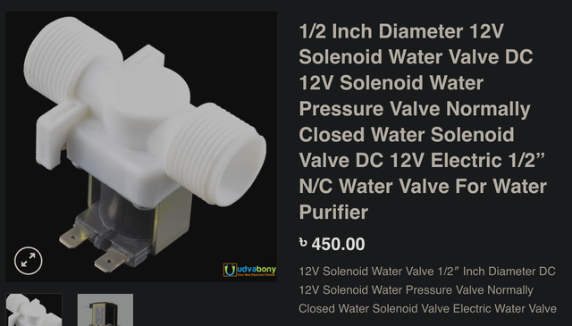

Slide 11
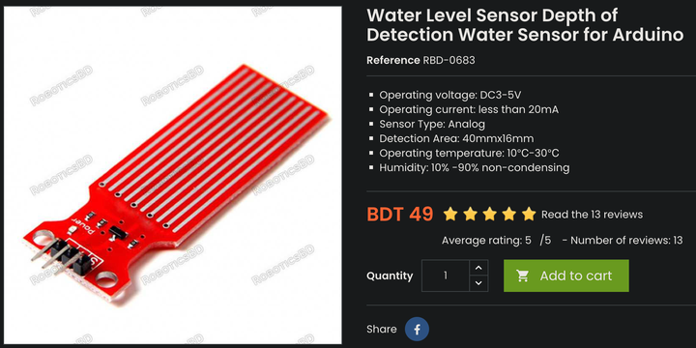

Slide 12
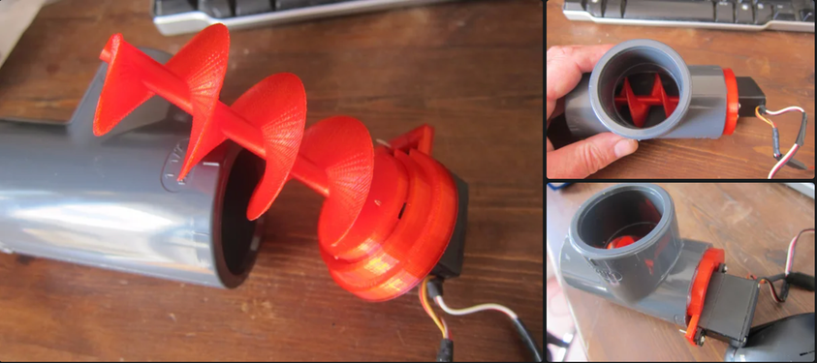

Slide 13
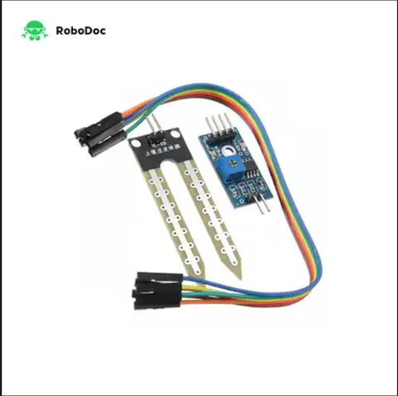
Soil moisture sensor

Slide 14
WATERING PLANTS FLOW DIAGRAM
Soil moisture drops
Waits fixed time
Closes value
Sensor detects it
ATMega32 opens valve

Slide 15
How the Soil Moisture Sensor Works
It has two probes that go into the soil.
It works like this: Wet soil = good conductor ⚡ | Dry soil = poor conductor 🚫
The sensor outputs a voltage level that changes based on moisture content.
The ATmega32 reads this analog signal through its ADC (Analog-to-Digital Converter) pin.
If the moisture is below a threshold, it triggers the valve to open and water the plant.

Slide 16
FEEDING WATER TO PET CAT
Water level low
Empties old water and opens refill valve
Fills to tequired level, then, Closes value
Sensor detects it
ATMega32 turns pump on

Slide 17
Cat Water Drinker — Sensor + Pump Operation
When water level falls below a certain point, water level sensor sends a digital/analog signal to ATmega32.
First, the pump activates to suck out any stale/old water.
Then, a clean water valve is opened.
The system monitors until the water level reaches the desired height.
Valve closes. Done. Water is fresh and topped off

Slide 18
CAT FEED DISPATCHER
Timer reaches a fixed limit (such as 6 hours)
Rotates dispenser
Drops cat food
ATmega32 activates motor

Slide 19
Food Dispatcher (Rotary Motor + 3D Printed Mechanism)
Motor runs every 6 hours for a specific duration (controlled by ATmega32 timer).
It rotates a portion of the container, releasing a set amount of dry food.
A circular or paddle-wheel style container is 3D printed.
As it turns, one “pocket” of food aligns with the opening and drops food.
After one cycle, it stops.

Slide 20
Preventing pet cat from exiting the house (LDR sensor + servo motor)
LDR sensor + servo motor: It detects light coming from a laser beam.
If light is blocked (by a passing pet cat) then the LDR sensor will trigger a servo motor to close the doors/windows.
The windows can be opened again using a Bluetooth module (HC-05)

Slide 21

THANK YOU

